Slide 1
FIRE DETECTION IN BUILDINGS AND FOREST USING OPENCV
201EC153 - GURUMOORTHI J
201EC120 - ATHIBAN S
Under guidance of
Mr/Dr.Gopal krishnan B,
Designation,
BIT,
Sathy.

Slide 2
Abstract
Wildfire is a part of nature. It plays a key role in shaping ecosystems by serving as an agent of renewal and change. But fire can be deadly, destroying homes, wildlife habitat and timber, and polluting the air with emissions harmful to human health. Fire also releases carbon dioxide—a key greenhouse gas—into the atmosphere. Fire effects are influenced by forest conditions before the fire and management action taken or not taken after the fire, and may be long-lasting.Now-a-days we are using sensors,But if we use sensors it might be affected on fire easily so that the exact the information will be lost easily.We are using an CCTV cameras using Artifical intellegence by the method of image processing.The captured image is send to google cloud by using wifi signal,the collected image from the googlecloud is processed by image processing using the library OpenCV,the library used are SMTPLIB & HTTP POST to Twilio message. OpenCV is used in computer vision.By Google Maps we call the API function to get the exact location of the CCTV camera’s.By using this technology we are able to detect the fires easily if the fire is spoted on the CCTV camera.Once the fire detected, the call will be automatically remind the nearest fire station.We use this kind of technology’s we are able to predict the exact location will be sent automatically to the fire service station

Slide 3
Problem Statement Addressed
Nowadays there are many fire accidents occurs day by day.Forest and buildings are get fire accidents due to some natural and aritifical ways so there is an issue in worldwide.whenever the fire accident occurs the fireservice are unable to reach the spot immediately.So we done the project to overcome the issue so whenever the fire accident occurs it will able save the life of humans and animals life.

Slide 4
Existing Solution to the Problem Addressed
On recent days we are using sensors to detect the fire accidents,but there is an issue it might be affected in fire so it will won’t be able sent the warnings.

Slide 5
Proposed Solution to the Problem Addressed
In this fire accidents we have decided to use CCTV cameras instead of sensors.
When the fire accident occurs usually sensor easily gets affected by fire but when we use cameras it won’t be easily caught by fire.So we have used cctv cameras instead of sensors.

Slide 6
Project Work Plan
Step 1: We have created an algorithm for cctv cameras to detect the fire accidents.
In this we train the models with fire.So when there is a fire it will able to detect it easily.
Step 2 : The pretrained models are motion detection,grey scale value,colour detection,region grow,region merge.
Step 3: When the fire is detected it will sent the gmail to nearest fire service station.
Step 4 : By the way using google API we call the location where the fire is detected.It will sent the location to nearest fire stations using wifi via whatsapp,gmail,telegram.
Step 5:When the fire is detected on the cameras it will call the nearest firestation.

Slide 7
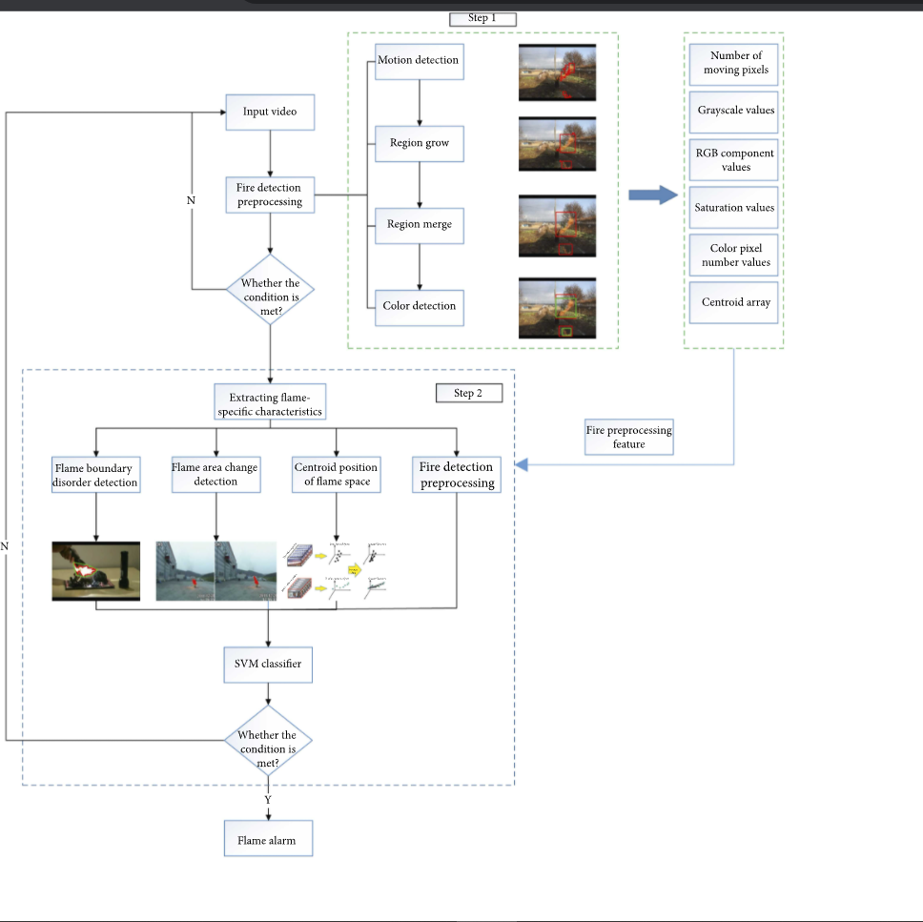
Block Diagram and/or Circuit Diagram

Slide 8
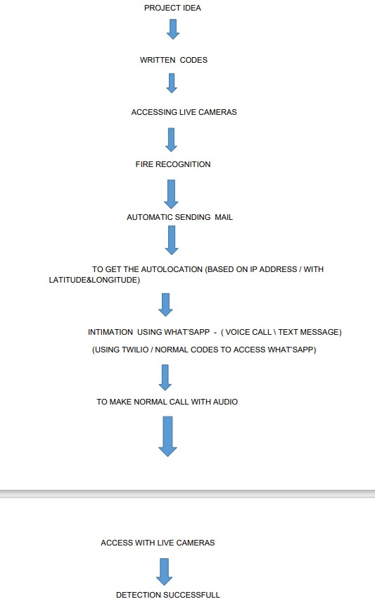
Flow Chart

Slide 9
Effective utilization of the Modern Tool & Cloud
We have used mordern tools such as ;
Google Cloud
Google Maps
Gmail
Twilio
Whatsapp
Telegram.
The reason we have chosen these platforms are free of cost, and it will be user friendly

Slide 10
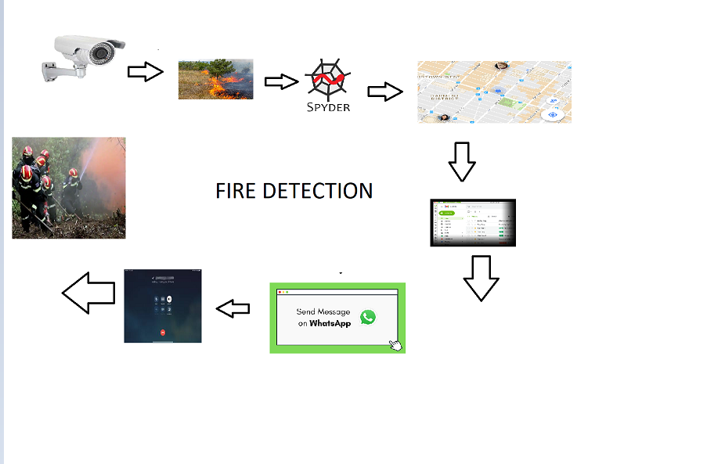
Technology stack & use case

Slide 11
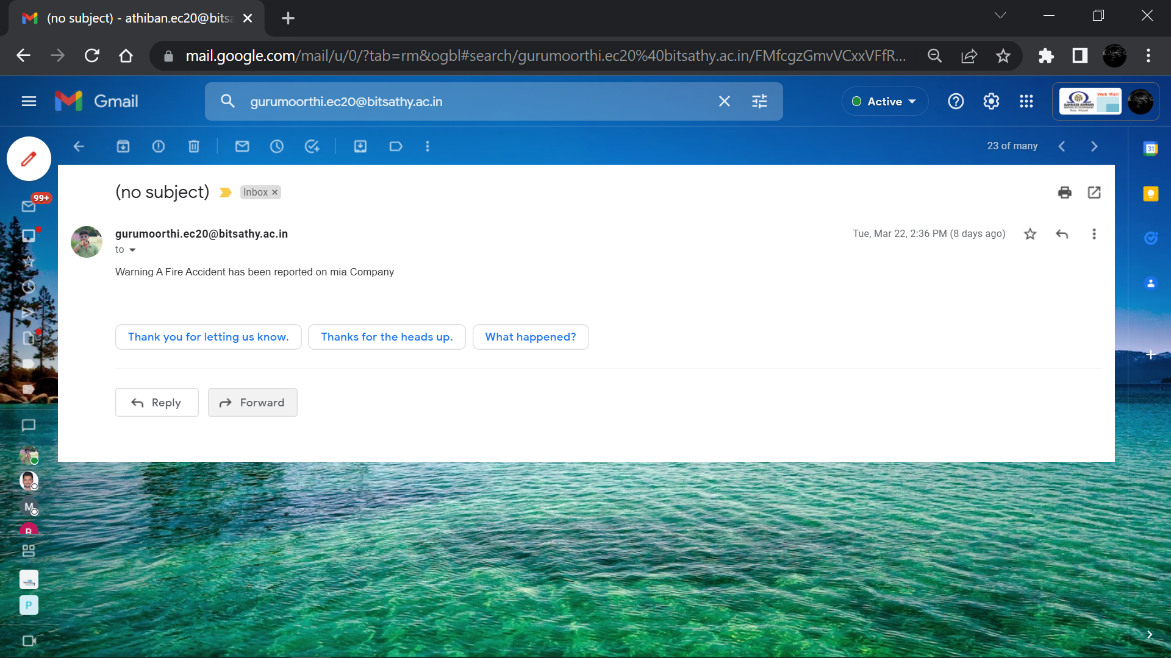
Prototype and Sample Output

Slide 12
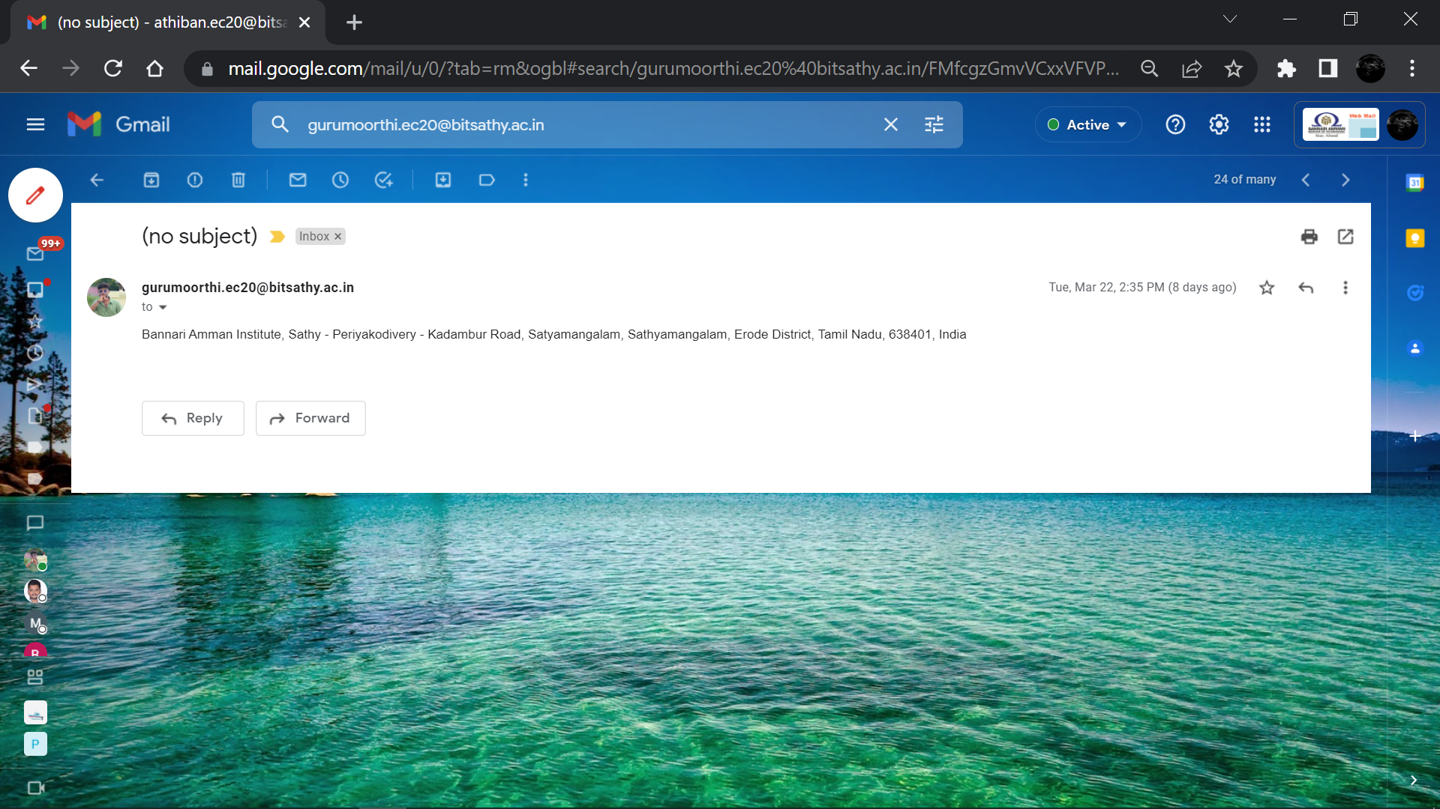

Slide 13
Analysis of Results & discussions
Advantages
In this fire accidents we have decided to use CCTV cameras instead of sensors.
When the fire accident occurs usually sensor easily gets affected by fire but when we use cameras it won’t be easily caught by fire.So we have used cctv cameras instead of sensors.
Disadvantage
It is difficult to provide wifi in all the places.

Slide 14
Cost Benefit Analysis (List of Components / Service Used)
(Budget)
S.No | Component Name | Specification (IC number or Range or Value) | Unit Cost | Total Cost
1 | Camera | IP8M-2496EW-28MM | 19,000 | 19,000
2 | wifi | 5G BAND | - | -

Slide 15
References
Fabrice Anon, Vijith Navarathinarasah, Chung-Horng “Building a Framework for Internet of Things and Cloud Computing”, 2014 IEEE International Conference on Internet of Things .
Julien Mineraud, Oleksiy Mazhelis, Xiang Su, Sasu Tarkoma,“A gap analysis of Internet-of-Things platforms”,2015
“Big Data Analytics in Future Internet of Things”, White paper Internet of Things 2015.
Lihong Jiang, Li Da Xu, Senior Member, IEEE, , “An IoTOriented Data Storage Framework in Cloud Computing Platform”, IEEE Transactions On Industrial Informatics, Vol. 10, No. 2, May 2014.

